Slide 1
Shear Strength of Soils
CE 544 – BRIGHAM YOUNG UNIVERSITY

Slide 2
Why is this important?
In order for analysis to be useful, must have correct problem, correctly formulated.
Requires
Mastery of soil mechanics
Knowledge of geology and site conditions
Knowledge of the properties of the soils at the site

Slide 3
Effective Stress
Total Stress:
Effective Stress:
Shear strength = f(σ’, n)

Slide 4
Direct Shear Test

Slide 5
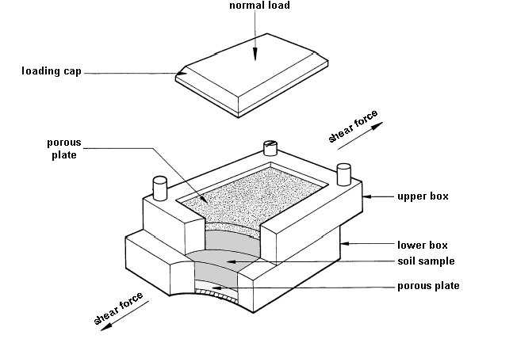
Direct Shear Test
Notes:
http://www.tonygraham.co.uk/house_repair/wattle_daub/soil%20shear%20test%20box.jpg

Slide 6
Test Results

Slide 7
Drained vs. Undrained
Drained
Water is able to flow out and pore pressures are allowed to dissipate
Undrained
No flow of water or the flow of water is too slow to adequately dissipate pore pressures due to loading or shearing.

Slide 8
Time required for drainage
t₉₉ = time required for 99% drainage
D = maximum drainage distance
C_{v} = coefficient of consolidation
(see figure 3.8 on page 28)

Slide 9
Effective Stresses
Effective stress changes whenever pore pressures change.
Causes for Δu:
Load applied/removed from soil
Dissipation of pore pressures due to drainage
Rising/falling water table
Dilation/compression due to shear stress

Slide 10
Effective Stresses
If the load is increased but drainage is not allowed to occur, effective stress does not change.

Slide 11
Effective Stress Failure Envelope

Slide 12
OC vs. NC Clays

Slide 13
Stress Paths
Drained stress path
Undrained stress path
Undrained stress path

Slide 14
Triaxial Test

Slide 15
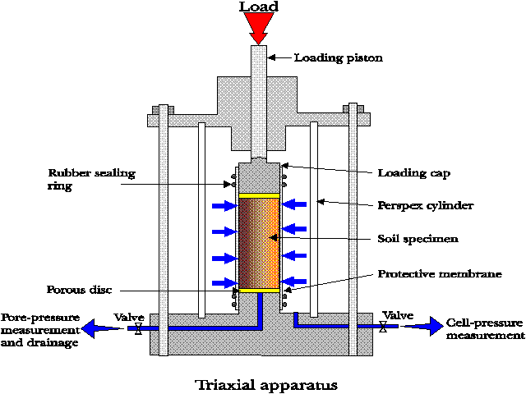
Triaxial Test Apparatus

Slide 16
Triaxial Test
Two types of test
Compression
Extension
Two stages in test
Consolidation
Shearing
Three types of drainage conditions
Consolidated drained (CD)
Consolidated undrained (CU)
Unconsolidated undrained (UU)

Slide 17
Compression Test

Slide 18
Consolidated Drained (CD) Test

Slide 19
CD Test, cont.
This is called CID or ICD (I = isotropic)

Slide 20
CD Test, cont.
Failure
σ_{c}
σ’_{1f}
σ’_{3f}

Slide 21
Mohr’s Circle and Failure Envelope
NC Clays or Loose Sands

Slide 22
Mohr’s Circle and Failure Envelope
OC Clays or Dense Sands

Slide 23
Consolidated Undrained (CU) Test

Slide 24
CU Test, cont.
σ₃’=? σ₁’=?
Total Stress Analysis

Slide 25
CU Test, cont.
Failure
σ_{c}
σ₁
=σ₃

Slide 26
CU-bar Test
u is measured
σ’₁= σ₁ - u
σ’₃= σ₃ - u
Effective stress analysis
Failure
σ’₃
σ’_{c}
σ’₁

Slide 27
CU vs. CU-bar Tests
φ_{cu} > φ_{cu} if u > 0
φ_{cu} < φ_{cu} if u < 0

Slide 28
Unconsolidated Undrained (UU) Test
Unsaturated Soils
Failure
σ_{c}
σ₁
=σ₃

Slide 29
UU Test, cont.
Saturated Soils:
Shear strength is a function of effective stress and density. Since neither change, strength is not affected by confining stress

Slide 30
UU Test, cont.
Undrained shear strength
= C_{uu}
= S_{u}
= 1/2(σ₁ – σ₃)_{f}

Slide 31
Unconfined Compression Test

Slide 32
Unconfined Compression Test
q_{u} = unconfined compressive strength
= (σ₁ – σ₂)_{f} = σ_{1f}
S_{u} = ½ q_{u}
Failure
S_{u}
σ_{3f}
σ_{1f}
q_{u}

Slide 33
C/P Diagrams (Su vs. Depth)
The undrained strength (Su) is a function of the in situ stress and soil density. Su generally increases with depth

Slide 34
Drained vs. Undrained
Which do you use?
Strength is a function of effective stress
Effective stress is a function of pore pressures and loading conditions
Need to carefully consider what happens to effective stress over time

Slide 35
Drained vs. Undrained
If effective stresses will increase over time, short-term or undrained conditions will be critical
If effective stresses will decrease over time, long-term or drained conditions may be critical

